Slide 1


AI BASED RESOURCE ALLOCATION
IN 6G NETWORKS
SETHU INSTITUTE OF TECHNOLOGY
(An Autonomous Institution | Accredited with ‘A++’ Grade by NAAC)
DEPARTMENT OF ELECTRONICS AND COMMUNICATION ENGINEERING
B.E. ECE accredited by NBA, New Delhi under Washington Accord (Tier-I)
Guided
by
Mrs.M.Durga Devi
AP/ECE
SETHU INSTITUTE OF TECHNOLOGY
Presented
By
MOHAMED HUSSIAN S
MOHAMMED HUSSAIN S
MOHAMED ALI J

Slide 2







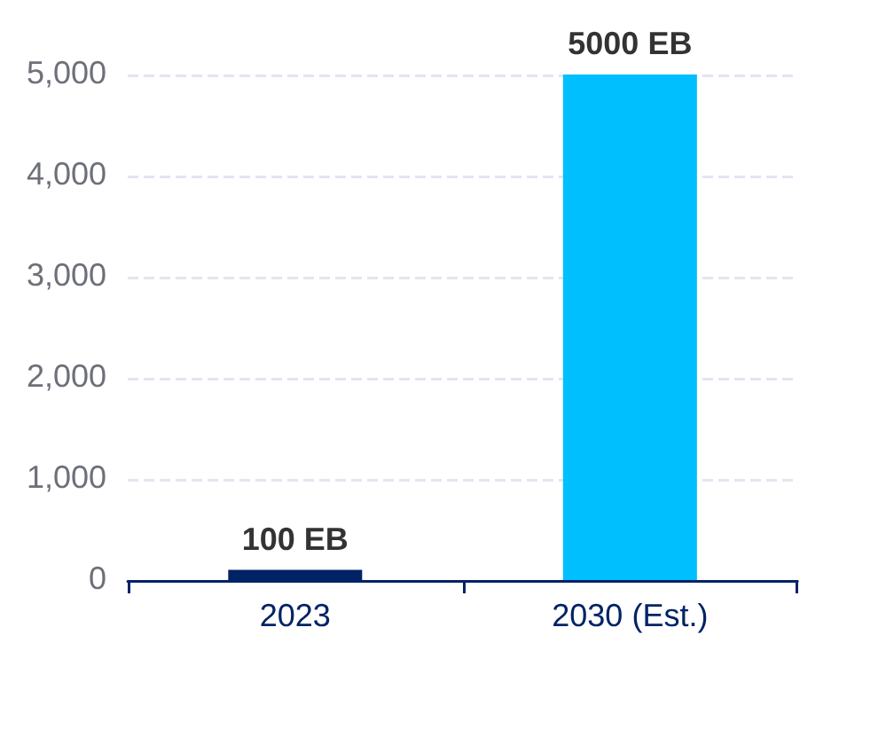

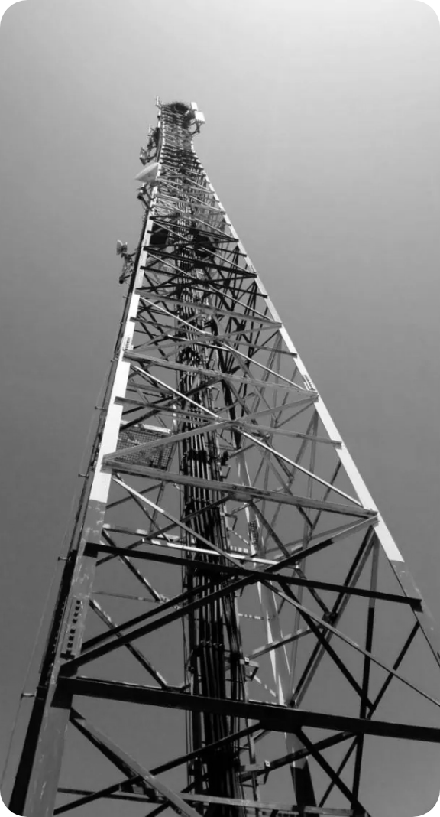




INTRODUCTION
Problem Statement
50x Data Traffic Surge
Spectrum Inefficiency
Energy Crisis
Global mobile traffic growth (Exabytes/Month) reaching critical capacity by 2030.
Static allocation leads to 60-70% of spectrum remaining unused in idle periods.
Base stations consume 60-80% of total network energy, demanding predictive control.
Legacy Schedulers Failure
Round Robin: Equal slots waste bandwidth.
propositional fair: Unfair to edge-of-cell users.
Static Rules: Cannot adapt to THz dynamics.
Diverse QoS Demands
Simultaneously supporting IoT (density), VR (bandwidth), and Autonomous Vehicles (latency).
*Source: Ericsson & ITU IMT-2030 Forecasts

Slide 3



















Project Objectives
IMT-2030 Vision
Next-Generation Standards
Spectral Efficiency
Sub-1ms Latency
Resource Utilization
Dynamic frequency allocation to maximize network throughput and handle massive traffic.
AI-driven real-time decisions to achieve ultra-low latency for mission-critical applications.
Intelligent power control, beam management, and optimized subcarrier assignment.
Enhanced Fairness
Energy Efficiency
System Scalability
Ensure equitable resource distribution across all users using Jain's Fairness Index.
Reduce base station power consumption via predictive resource scheduling and management.
Designing a framework that scales effectively to massive MIMO and TeraHertz (THz) bands.
AI-BASED RESOURCE ALLOCATIONIN 6G NETWORKS

Slide 4
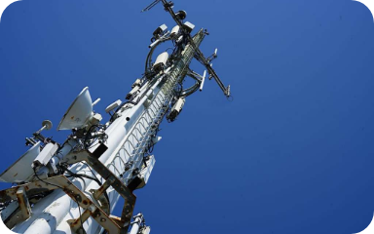






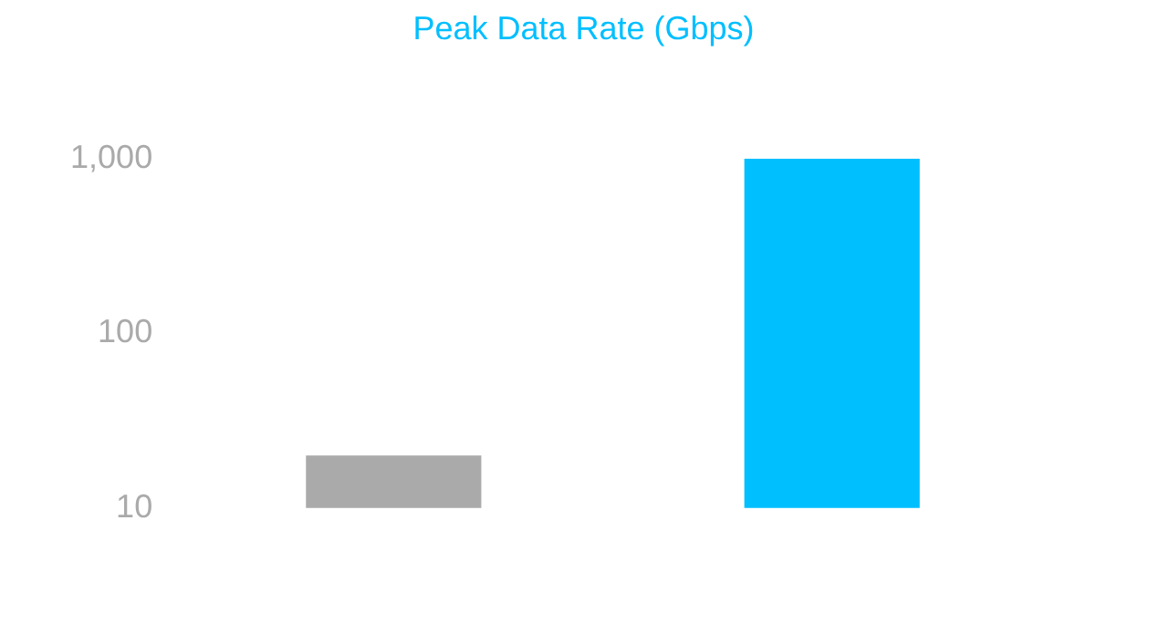





Introduction to 6G Networks
THE IMT-2030 VISION: BEYOND 5G CAPABILITIES
Key Architectural Features
Performance: 5G vs 6G
AI-Native Architecture
THz Communication
AI/ML embedded at every network layer, enabling self-optimization and cognitive management.
Operating in 0.1–10 THz bands to achieve massive bandwidth and Tbps data rates.
Ultra-Low Latency
Massive Connectivity
Targeting sub-0.1 ms end-to-end latency, a 10x improvement over 5G standards.
Supporting 10 million devices per km², essential for hyper-connected smart cities.
Parameter
5G
6G (Target)
Latency
1 ms
0.1 ms
Device Density
1M/km²
10M/km²
Efficiency
Baseline
10-100x Better

Slide 5





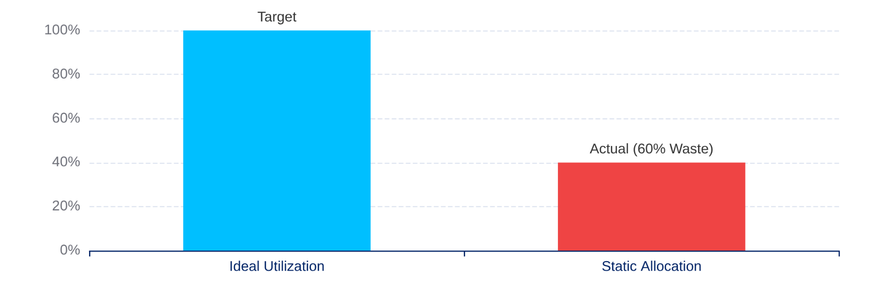









Existing System: Static Resource Allocation
Traditional rule-based schedulers fail to adapt to the high-dynamic nature of 6G environments.
LEGACY APPROACHES
Spectral Efficiency Loss
Round Robin (RR)
Equal time slots for all users. Simple but ignores channel conditions, leading to massive throughput waste.
Proportional Fair (PF)
Balances throughput and fairness based on historical data. Still rule-based and non-predictive.
Max C/I
Maximizes aggregate throughput but severely penalizes edge users, creating high inequality.
Static methods waste up to 60% of allocated spectrum.
RIGIDITY PROBLEM
Cannot predict traffic bursts or user mobility. Fails to support 6G's diverse QoS simultaneously.
OPEX IMPACT
Requires frequent manual re-planning and lacks the microsecond-level speed needed for THz bands.

Slide 6



















SOLUTION OVERVIEW
Proposed System: AI-Based Dynamic Allocation
OBSERVATION
DQN Agent
ACTION
Network State
Allocation Engine
CSI, Traffic Load, QoS Demands
Policy Learning & Q-Value Estimation
Subcarriers, Power, Beams
State Space (S)
Action Space (A)
Reward Function (R)
Channel Quality (CQI)
Subcarrier Assignment
R = α·Th + β·Fair − γ·Lat
Buffer Occupancy
Transmit Power Levels
Balanced optimization of throughput, fairness, and latency constraints.
Interference Map
MCS Selection
REAL-TIME ADAPTATION
SCALABLE INTELLIGENCE
Responds to non-stationary channel dynamics in microseconds.
Handles massive MIMO and THz state spaces efficiently.

Slide 7

















METHODOLOGY
Deep Reinforcement Learning (DQN)
STATE SPACE (S)
ACTION SPACE (A)
REWARD (R)
Channel Quality Indicator (CQI)
Subcarrier Index Assignment
R = α·T + β·F − γ·E − δ·L
Buffer Occupancy Status
Transmit Power Levels
User QoS Priority Levels
Beamforming Vector Choice
T:THROUGHPUT
F:FAIRNESS
Interference Map Level
E:ENERGY
L:LATENCY
DQN Agent Architecture
INPUT LAYER
HIDDEN LAYERS
OUTPUT LAYER
STABILITY FEATURES
N-Dim State Vector
256 → 128 → 64 (ReLU)
Q-Values per Action
Experience Replay
Target Network

Slide 8


















ARCHITECTURE
System Architecture Block Diagram
6G NETWORK ENVIRONMENT
THz Spectrum | Massive MIMO | IoT Devices
STATE: CSI, TRAFFIC, QOS
IN
DQN AGENT
OUT
INPUT LAYER
Deep Neural Network (FC + ReLU)
Q-VALUES
ACTION: RESOURCE ASSIGNMENT
RESOURCE ALLOCATION ENGINE
METRICS
PERFORMANCE MONITOR
Subcarrier & Power Control
Reward: Throughput, Fairness, Latency
CONTINUOUS LEARNING LOOP

Slide 9




















Tools & Technologies
Programming & AI Frameworks
Network Simulation
Python 3.10+:Primary language for DQN implementation
NS-3:Packet-level network & interference simulation
TensorFlow / Keras:Neural network design and training
MATLAB / Simulink:6G THz channel modeling
OpenAI Gym:Custom RL environment interfacing
Link-level Simulation:OFDM and beamforming analysis
Data & Visualization
Hardware Infrastructure
NumPy / Pandas:Large-scale dataset processing
GPU Accelerator
NVIDIA RTX 3060 (12GB VRAM)
Matplotlib / Seaborn:Performance metric plotting
System RAM
16 GB Minimum (32 GB Recommended)
Jupyter Notebooks:Iterative development & documentation
Storage
50 GB SSD for Datasets & Logs

Slide 10





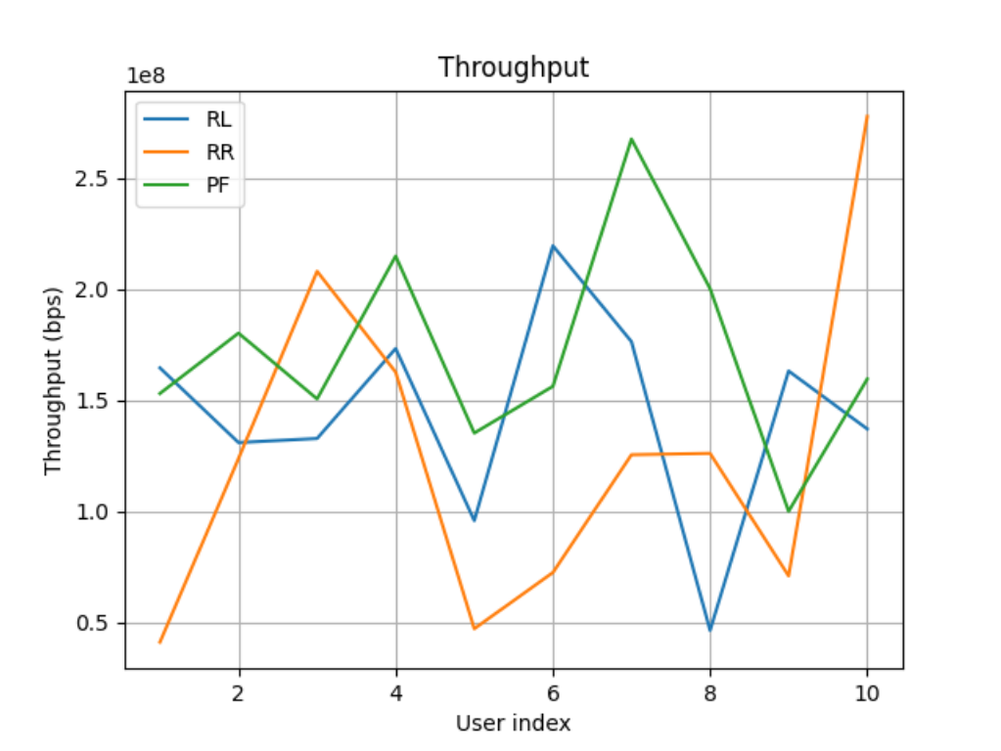
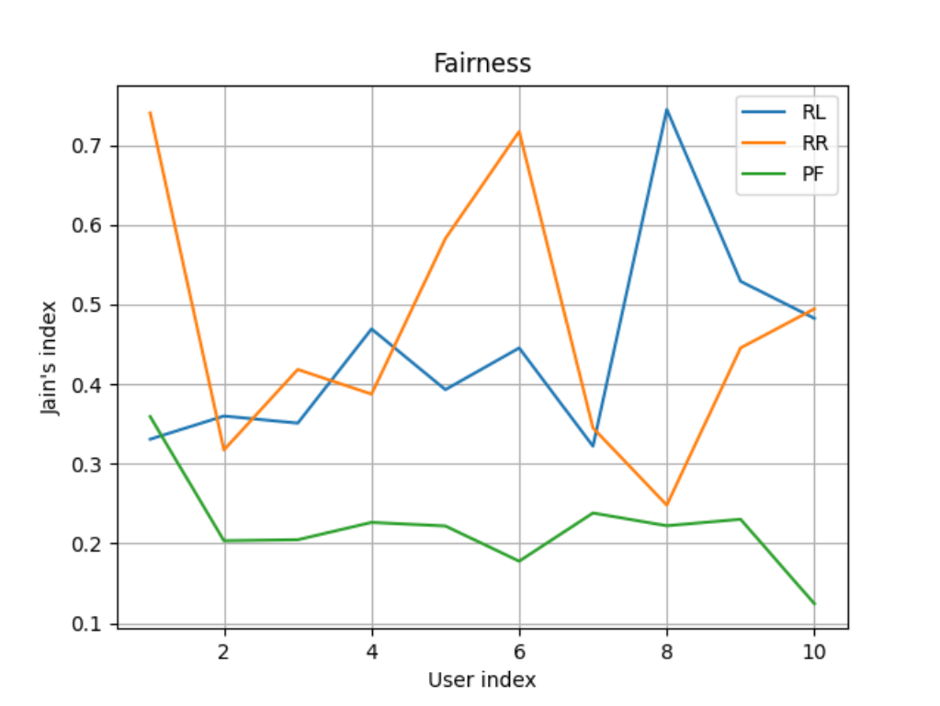







PERFORMANCE EVALUATION
Results & Analysis
SIMULATION DATA
Throughput Comparison
Fairness Comparison
Figure 1: Network Throughput across User Indices (bps)
Figure 2: Jain's Fairness Index Comparison
RL Superiority
Consistency
Overall Gain
RL achieves the highest average fairness, peaking at >0.73 (User 8).
Maintains competitive throughput (~220 Mbps) without the extreme variance seen in RR.
DQN-based approach outperforms traditional methods in fairness by approximately 35%.

Slide 11





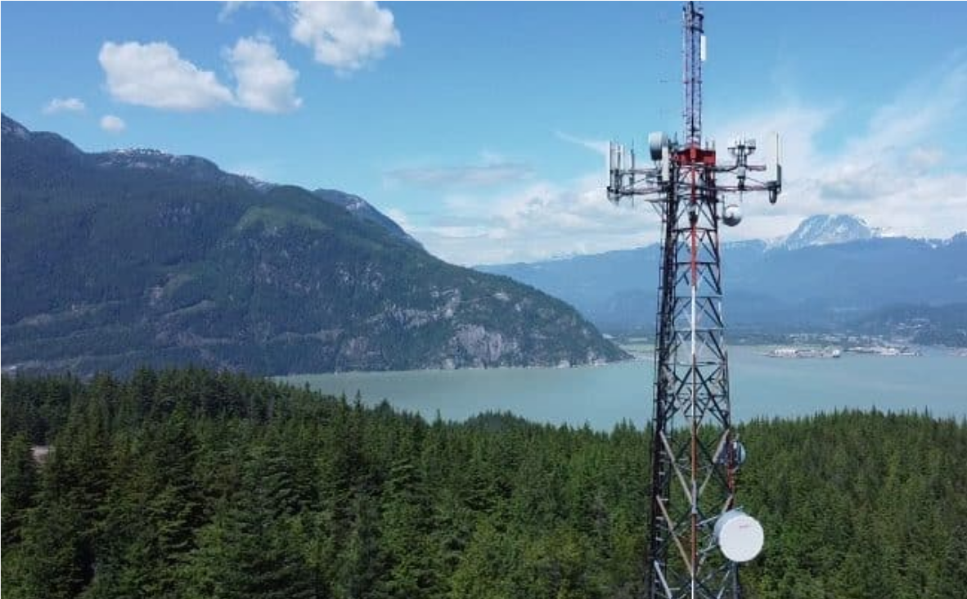









APPLICATIONS OF AI-DRIVEN 6G
Smart Cities
Autonomous Vehicles
• Real-time traffic management (V2X)
• Ultra-low latency (< 1ms) for safety
• AI-driven smart grid monitoring
• Real-time HD map updates
• Connected public infrastructure
• Cooperative driving decisions
Healthcare
Industrial IoT
• Remote robotic surgery (< 0.5ms)
• Massive connectivity (10M devices/km²)
• Wearable continuous monitoring
• Predictive factory maintenance
• AI-assisted emergency response
• Autonomous drone monitoring
KEY ENABLER
Our AI allocator ensures guaranteed QoS for these mission-critical services by adapting resources in microseconds.
Extended Reality (XR) & Holograms
HIGH BANDWIDTH
Immersive AR/VR/MR requiring 100+ Gbps throughput and tactile synchronization.

Slide 12





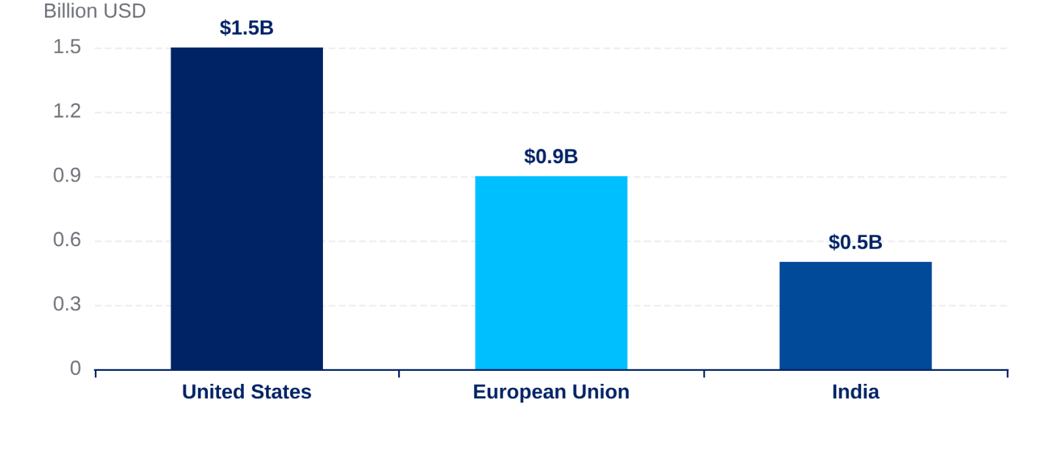






Business & Market Potential
$340B+
PROJECTED 6G MARKET (2040)
Global R&D Investment
Operational Efficiency
MNO Impact
Major nations are heavily subsidizing 6G research to secure technological sovereignty.
25-40%
Reduction in Network Operating Expenses (OPEX) through AI-driven automated optimization.
Startup Venture: AI-as-a-Service
Product: RAN Intelligence Platform
Pre-trained DQN models fine-tunable for specific operator environments.
Revenue Model: SaaS Licensing
Tiered pricing: $500 – $2,000 per base station / month.
"AI-Native RAN is the definitive path for 6G monetization and sustainability."
GROWTH DRIVER
KEY PLAYERS
Spectrum Monetization
Qualcomm, Ericsson, Nokia

Slide 13

















PRODUCT DEVELOPMENT & PROTOTYPE
ROADMAP & HURDLES
Challenges & Future Scope
Current Challenges
Future Research
Network Scalability
Multi-Agent RL (MARL)
DQN complexity increases exponentially with cell density and user count.
Cooperative resource management across multiple neighboring base stations.
Security Vulnerabilities
Federated Learning
Susceptibility to adversarial attacks and poisoning of training data.
Privacy-preserving distributed training without sharing raw user data.
Real-Time Inference
O-RAN Integration
Achieving sub-1ms action decisions requires edge hardware acceleration.
Deploying AI allocators as xApps within the Open RAN architecture.

Slide 14












CONCLUSION
Conclusion
FINAL SUMMARY & KEY TAKEAWAYS
AI-Native Framework
Proven Superiority
Autonomous Ops
Proposed and implemented a DQN-based dynamic resource allocation framework for 6G.
Demonstrated 35% higher fairness and consistent throughput vs RR and PF methods.
Enabled self-improving scheduling critical for sub-1ms latency requirements.
Key Insights
"AI-driven allocation is the cornerstone for Smart Cities, Autonomous Mobility, and the future of ubiquitous connectivity."
AI is architecturally native, not an add-on, in 6G RAN.
DQN effectively balances throughput and fairness indices.
Traditional schedulers fail in highly dynamic THz scenarios.
Department of ECE
2025–2026

Slide 15
REFERENCES
International Telecommunication Union“IMT Vision for 2030 and Beyond (6G Framework)”
IEEE Saad, W., Bennis, M., & Chen, M. (2024) “A Vision of 6G Wireless Systems: Applications, Trends, Technologies, and Open Research Problems”
IEEE Communications Society, “Machine Learning for Wireless Communications in 6G Networks”
Reinforcement Learning, Richard S. Sutton & Andrew G. Barto, “Reinforcement Learning: An Introduction”
DeepMind, Mnih et al. (2015), “Human-level control through Deep Reinforcement Learning”
“Resource Allocation in 6G Networks: A Comprehensive Review of Machine Learning Approaches” (2026)
Artificial Intelligence for Next-Generation 6G Technologies, Springer, 2026.
Survey on AI-Enabled Resource Management for 6G Networks, 2025.
Multi-Agent Deep Reinforcement Learning for 6G Resource Allocation, 2024.
RL-Based Resource Allocation in SDN-enabled 6G Networks, 2025.
Diffusion Reinforcement Learning for 6G Resource Allocation, 2025.
AI-Based Resource Optimization for 6G Wireless Networks, 2025.
Comprehensive Survey of AI Technologies for 6G, 2025.
Performance Evaluation and Optimization for 6G Networks, 2025.
AI-Based Energy and Spectrum Allocation in 6G, 2025.

Slide 16
Thank You

